Slide 1


DataBase Logic in Business Applications
Al.I. Cuza University of Iași
Faculty of Economics and Business Administration
Department of Accounting, Information Systems
and Statistics
Business Rules with Scheduler
By Marin Fotache & Co.

Slide 2
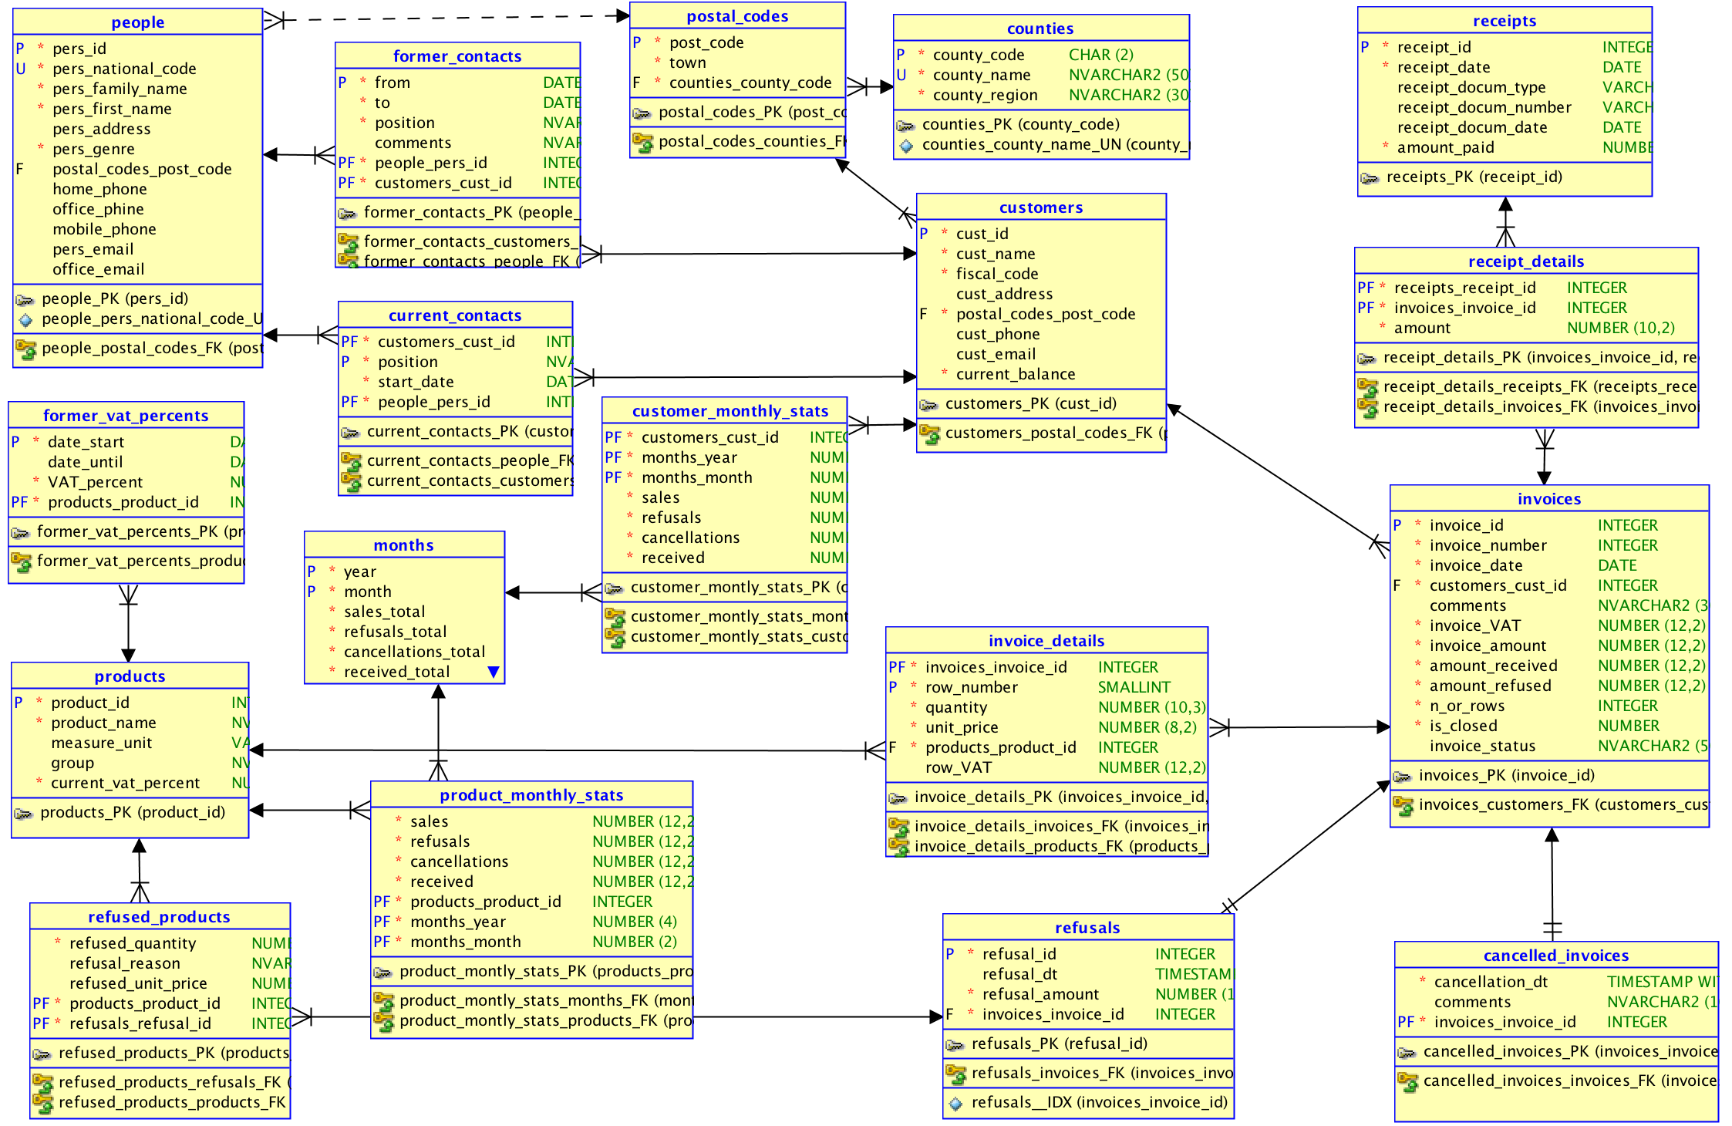
Database schema

Slide 3
Script on GitHub
07_Business Rules with PL SQL:
https://github.com/marinfotache/Database-Logic-in-Business-Applications/tree/master/06_Triggers
Prerequisites (for setting up the database to this point)
06-00-2_fixed_DDL_script_sales_2015.sql
06-00-3_add_constraints_sales_2015.sql
06-01a_en_sequences.sql
06-01b_en_data_cleaning__surrogate_keys.sql
06-01c_en_cascade_updates.sql
06-02a_en_triggers_invoices.sql
06-02b_en_triggers__invoice_details.sql
06-02c_en_triggers__receipts__receipts_details.sql
06-02d_en_proc_auto_ins__receipts.sql

Slide 4
07-03_BusinessRules_and_Scheduler.sql
Business Rules Implemented with Oracle Scheduler - example 1: automatic closing of invoices (at 23:00 all open invoices will be automaticall closed by setting the value of attribute "is_closed" on value "Y”)
Business Rules Implemented with Oracle Scheduler - example 2: compute and store details about penalties for unpaid invoices (after the payment deadline)

